Slide 1

PROGRAMMEERPROJECT VRIJSTELLINGEN & TRAJECTEN
HOWEST
2015
Notes:
[JOACHIM]

Slide 2




Team
Joachim Bockland
CCCP
Tiem Pauwaert
CCCP
Toon Swyzen
CCCP
Sam De Creus
SSD
Programmeerproject 2015
Notes:
[JOACHIM]We are Joachim, Tiem, Toon and Sam

Slide 3
The problem
Programmeerproject 2015
Notes:
[TOON]
The problem right now is that everything is done on paper.
As you can see this is quite some work for everyone that is involved in the process.
We made an online webapplication which will make everything a lot easier.

Slide 4
Front-end
Programmeerproject 2015
Notes:
[TOON]
For our front-end we’ve used html and css together with a custom bootstrap theme for some better looks.
We also made use of jQuery to create a better user experience.

Slide 5
Back-end
Programmeerproject 2015
Notes:
[JOACHIM] When our project was introduced to us we were told that we could choose what we wanted as back-end.
So after some research and discussion we opted for node.js because it’s a fairly new platform and it’s a lot faster than php and asp.net.

Slide 6
Back-end
Programmeerproject 2015
Notes:
[JOACHIM] But because we had to use a server from school because we needed access to identity and bamaflex, we had no other choice then to go with asp.net.
-- Nog wa uitleg over asp.net --

Slide 7

iBaMaFlex!
Retrieve (personal) data about
Students
Teachers
Courses
Programmeerproject 2015
Notes:
iBamaflex provides us with most of our initial data, thanks to the use of it’s features we are able to link students to the courses they registered for aswell as some data like full names, education, even telephone numbers and such. To ensure optimal uptime of our website and reliability of our data we cache most of the required data in our own local database. This was a request from our client, being sir Sourie.

Slide 8
Identity Service
Identification
Programmeerproject 2015
Notes:
Identity provides us with a service connected to a database of user Logins and their personal passwords. Although we obviously aren’t allowed to retrieve passwords of users we can still use the Identity Service to authenticate users. This is an important feature because it allowed us to use the existing howest accounts rather than having to force new users to make a brand new account. It’s important to know that both Identity Services aswell as iBamaflex Services can only be used by Devices in a certian IP range, this made local testing of certian features impossible. Hence we realised that for this reason, and the fact that we would have to cache iBamaflex data anyway, we would require our own database.

Slide 9

Our database
172.21.1.84
SQL
Used for
Caching
Saving student files, applications, …
Saving email-message data
Programmeerproject 2015
Notes:
So to complete the picture we added our own database. After logging in to our platform once, close to all further actions can be performed by that user without consulting Identity or Ibamaflex services. The advantage of this is that we are not 100% reliant on the uptime of these services. In other words when either of these services become unavailable our application can still run for previously logged users using the cache data. State of student files and applications are also stored here.

Slide 10
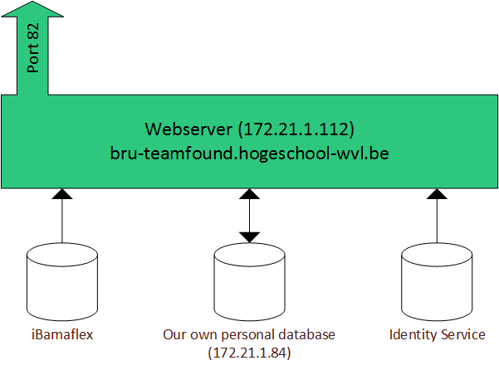
Overview of the Infrastructure setup
Our webplatform
Proof directory
Programmeerproject 2015
Notes:
[TIEM] Our webplatform runs on the teamfound server, you can acces it by surfing to port 82. Currently this website is only accessible from within the school network. We have a share on the server where we can publish our solution and the way IIS is set up it will load the build whenever someone requests it. Aside from the website directory we also have a directory in which users can store files which will serve as proof for an application.
Even during testing phase, we have to make use of the publish feature to useiBamaflex and Identity Services. This is not ideal because during these testing periods the live website may contain bugs. This was another reason why we started caching Ibamaflex and Identity service data, that way we could test most of the functionality on our local devices.

Slide 11
Version control
Github
Programmeerproject 2015
Notes:
[TIEM] To store our source code we use a private GitHub repository. Each of us would frequently commit and push new and added features, Github proved to be a great tool to merge our versions together and share them between the four of us. Combining this with a client application called SourceTree makes for a very user friendly experience.

Slide 12
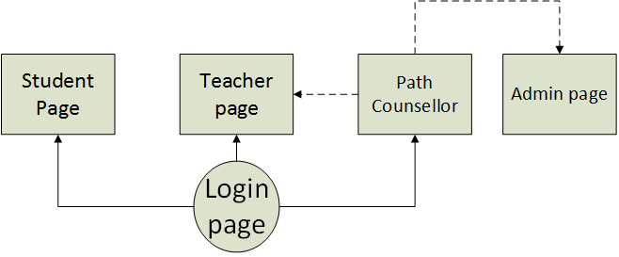
Application flow
Programmeerproject 2015
Notes:
[TOON]
New users are by default directed to a login page, after logging in we analyze the type user we are dealing with and redirect him or her to the correct dashboard page, There are three main dashboards, one for students, one for teachers and one for path counsellors. Aside from these three pages there is also the admin page, admins can configure certain settings such as assigning a counsellor role to a teacher or adjusting the email frequency threshold. It’s also important to keep in mind that counsellors can be teachers aswell, meaning they need acces to both dashboards and they need to be able to switch between these without logging out and/or using a second account.

Slide 13
Demo time
Go to: http://bru-teamfound.hogeschool-wvl.be:82/
Programmeerproject 2015
Notes:
We’ll now present a demo of what we have made so far.

Slide 14
Future
To be implemented:
Print the finished document
Notify the teachers on new waiting applications
Programmeerproject 2015
Notes:
[TIEM] As you can see there are still a few things that need to be implemented like:
Priting a finished document we realise this is an essential (last) step in the process but we simply couldn’t figure this out in time for the presentation today. Instead we focussed on fixing bugs to show that what we did have in fact worked and worked well.
In essence the Counsellor would request to print a finalized document and the server would then make up a .pdf document and send it back to the user. The user could then print it or save it at his own will. In fact implementing this feature would not require that much coding if we used an ASP library to do the functionality for us, sadly most of these libraries are not free.

Slide 15
Future
To be implemented:
Print the finished document
Notify the teachers on new waiting applications
Programmeerproject 2015
Notes:
[TIEM] Notifying teachers. Currently we have this set up with a yahoo email account, emails are sent to the respective teachers upon creation of a new application regarding their courses aswell as when a counsellor requests a reminder to be sent to a teacher after an unduly waiting time. We have been in debate about this feature because we know nobody likes notification emails, however from the counsellor point of view this seems to be the best option to ensure teachers do their job. To prevent teachers from being overflown with these emails however, the administrator can limit the minimum waiting time between mails. All these features have been implemented and worked in previous versions, however because we can’t link teachers to Applications because iBamaflex has no feature for this our current mailing system is not ready for testing.

Slide 16
THANK YOU FOR YOUR ATTENTION!
HOWEST
2015
Notes:
[TIEM] We would like to thank you for your attention,
and if there are any questions feel free to ask.

